Slide 1
Computational Complexity

Slide 2
Computational Complexity
important use is in reference to a problem itself. The theory of computational complexity involves classifying problems according to their inherent tractability or intractability — that is, whether they are “easy” or “hard” to solve. This classification scheme includes the well-known classes P and NP; the terms “NP-complete” and “NP-hard” are related to the class NP.
Notes:
Tractability - easily managed or controlled
Inherent - existing as a natural or basic part of something

Slide 3
Purpose of this talk
Understand P and NP
See what it would mean for them to be equal (or distinct)
See some examples
  SAT (Satisfaction)
  Minesweeper
  Tetris
Notes:
Distinct - recognizably different in nature from something else of a similar type.

Slide 4
P and NP, informally
P and NP are two classes of problems that can be solved by computers.
P problems can be solved quickly.
  Quickly means seconds or minutes, maybe even hours.
NP problems can be solved slowly.
  Slowly can mean hundreds or thousands or years.

Slide 5
An equivalent question
Is there a clever way to turn a slow algorithm into a fast one?
  If P=NP, the answer is yes.
  If P≠NP, the answer is no.

Slide 6
Why do we care?
People like things to work fast.
Encrypting information
  If there’s an easy way to turn a slow algorithm into a fast one, there’s an easy way to crack encrypted information.
  This is bad for government secret stuff and for people who like to buy things online.

Slide 7
Currently…
Most people think P≠NP.

Slide 8
General computing
First, consider computer programs and what they can do:
input
Program
output
(we hope)

Slide 9
General computing
They don’t always behave so nicely…
input
Program
No output
(Crash!)
Gets stuck here.

Slide 10
What happens when things get stuck?
Consider the program below:
Program:
L1. If x < 15, output 1.
Otherwise, GOTO L1.
Input: number x
Output:
1 if x < 15,
Never stops otherwise.

Slide 11
A couple of things to note
There are lots of programs for any given problem.
Some are faster than others.
  We can always artificially slow them down.

Slide 12
Back to P and NP
P and NP are classes of solvable problems.
Solvable means that there’s a program that takes an input, runs for a while, but eventually stops and gives the answer.

Slide 13
Computation “trees” for solvable problems
Program:
Input x
L1. If x > 1,
set x = x-2,
and GoTo L1.
If x = 0,
output 0.
If x = 1,
output 1.
Example computation:
Input x = 3
x>1, so …
x = 3 - 2 = 1
x=1, so …
Output 1

Slide 14
More about the example…
What does this program do?
  Outputs 0 if input is even,
  Outputs 1 if input is odd.
Solves the problem “Is the input even or odd?”
The length of the computation tree depends on the input.
  Time(3)= 2
  Time(4)= 3
  Time(x)≤ (x/2) + 1

Slide 15
Solvability versus Tractability
A problem is solvable if there is a program that always stops and gives the answer.
The number of steps it takes depends on the input.
A problem is tractable or in the class P if it is solvable and we can say Time(x)≤(some polynomial).

Slide 16
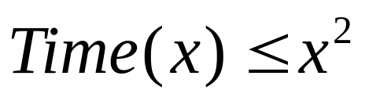
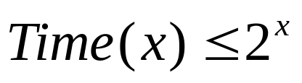
P problems are “fast”
These problems are comparatively fast.
For example, consider a program that has compared to one with
.
  On the input 100, the computation times compare as follows

Slide 17
Okay… so what about NP?
The description involves non-deterministic programming.
  NP stands for “non-deterministic, polynomial-time computable”
The examples we’ve seen so far are examples of deterministic programs.
  By the way, P stands for “polynomial-time computable”

Slide 18
An example of non-deterministic programming
Non-deterministic programs use a new kind of command that normal programs can’t really use.
Basically, they can guess the answer and then check to see if the guess was right.
And they can guess all possible answers simultaneously (as long as it’s only finitely many).

Slide 19
An example of non-deterministic programming
We branch when there’s a guess; one path for each guess.
Input x = 7
Program:
Input x.
Guess y in {1, 2, 4, 9}.
If x+y > 10,
stop and output 0.
Otherwise,
If y is even,
Guess z in {2, 3},
If x+z is odd, stop,
output 1.
Otherwise, output 0.
guess y = 1
guess y = 2
guess y = 4
guess y = 9
x+y>10
x+y>10,
Output 0
x+y>10,
Output 0
guess z = 2
guess z = 3
y is odd,
Output 0
x+z = 9 is odd,
Output 1
x+z = 10 is even
Output 0

Slide 20
Non-deterministic programming
Convention:
  If any computation path ends with a 1, the answer to the problem is 1 (we count this as “yes”).
  If all computation paths end with a 0, the answer to the problem is 0 (we count this as “no”).
  Otherwise, we say the computation does not converge.
Again, we’re only interested in problems where this third case never happens – solvable problems.
Notes:
Converge - tend to meet at a point.

Slide 21
The class NP
If the computation halts on input x, the length of the longest path is NTime(x).
A problem is NP if it is solvable and there is a non-deterministic program that computes it so that NTime(x)≤(Some polynomial).

Slide 22
Non-deterministic → Deterministic
A non-deterministic algorithm can be converted into a deterministic algorithm at the cost of time.
Usually, the increase in computation time is exponential.
This means, for normal computers, (deterministic ones), NP problems are slow.

Slide 23
The picture so far…
P
NP
All solvable problems

Slide 24

SAT (The problem of satisfiabity)
Take a statement in propositional logic, (like , for example).
The problem is to determine if it is satisfiable. (In other words, is there a line in the truth table for this statement that has a “T” at the end of it.)
This problem can be solved in polynomial time with a non-deterministic program.

Slide 25
SAT, cont.
We can see this by thinking about the process of constructing a truth table, and what a non-deterministic algorithm would do:

Slide 26
SAT, cont.
The length of each path in the computation tree is a polynomial function of the length of the input statement.
SAT is an NP problem.

Slide 27
NP completeness
If P≠NP, SAT is a witness of this fact, that is, SAT is NP but not P.
It is among the “hardest” of the NP problems: any other NP problem can be coded into it in the following sense.
If R is a non-deterministic, polynomial-time algorithm that solves another NP problem, then for any input, x, we can quickly find a formula, f, so that f is satisfiable when R halts on x with output 1, and f is not satisfiable when R halts on x with output 0.

Slide 28
NP complete problems
Problems with this property that all NP problems can be coded into them are called NP-hard.
If they are also NP, they are called NP-complete.
If P and NP are different, then the NP-complete problems are NP, but not P.

Slide 29
The picture so far…
P
NP
All solvable problems

Slide 30
The picture so far…
P
SAT lives here
NP-complete problems
NP
All solvable problems

Slide 31
Question:
Is there a clever way to change a non-deterministic polynomial time algorithm into a deterministic polynomial time algorithm, without an exponential increase in computation time?
If we can compute an NP complete problem quickly then all NP problems are solvable in deterministic polynomial time.

Slide 32
On to examples…
SAT is NP-complete
The Minesweeper Consistency Problem
Tetris

Slide 33
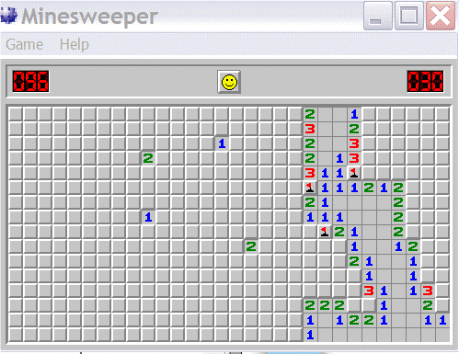
Minesweeper

Slide 34
Minesweeper
The Minesweeper consistency problem:
  Given a rectangular grid partially marked with numbers and/or mines – some squares being left blank – determine if there is some pattern of mines in the blank squares that give rise to the numbers seen. That is, determine if the grid is consistent for the rules of the game.

Slide 35
Minesweeper
This is certainly an NP problem:
  We can guess all possible configurations of mines in the blank squares and see if any work.
To see that it is NP complete is much harder.
  The trick is to code logical expressions into partially filled minesweeper grids. Then we will have demonstrated that SAT can be coded into Minesweeper, so Minesweeper is also NP-complete.

Slide 36
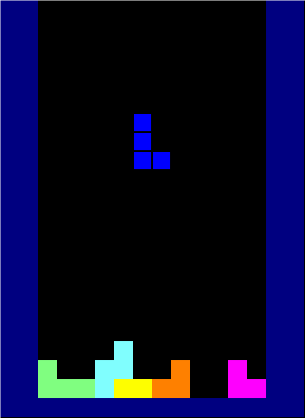
Tetris
Rules:
The pieces fall, you can rotate them.
When a line gets all filled up, it is “cleared”.
If 4 lines get filled simultaneously, that’s a “Tetris” – extra points!
You lose if the screen fills up so no new pieces can appear.

Slide 37
Tetris, the “offline” version
You get to know all the pieces (there will only be finitely many in this version), and the order they will appear.
You start with a partially filled board.

Slide 38
Tetris, offline
The following problems are NP-complete:
  Maximizing the number of rows cleared.
  Maximizing the number of pieces placed before losing.
  Maximizing the number of Tetrises.
  Maximizing the height of the highest filled gridsquare over the course of the sequence.

Slide 39
Tetris, offline
It’s easy to see each of these is NP – just guess the different ways to rotate and place each piece, and see which is largest.
It’s (as usual) harder to show NP-completeness.
  It is shown by reducing the 3-Partition problem (which is known to be NP-complete) to the Tetris problems.

Slide 40

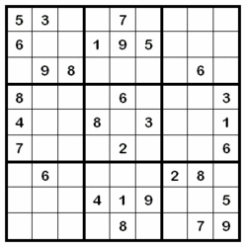
Sudoku
Each row/column/square has a single instance of each number 1-9.
Solving a board is NP-complete.
(Due to Takyuki Yato and Takahiro Seta at the University of Tokyo)

Slide 41
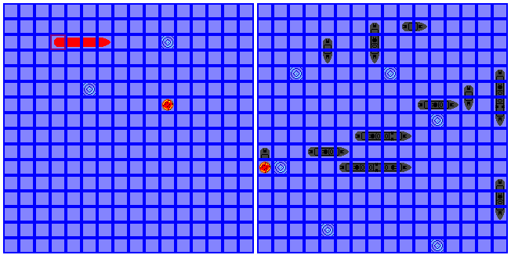
Battleship
Sink the enemy’s ships – NP Compete!

Slide 42


Beyond NP
Chess and checkers are both EXPTIME-complete – solvable with a deterministic program with computation bounded by for some polynomial .
Go (with the Japanese rules) is as well.
Go (American rules) and Othello are PSPACE-hard, and Othello is PSPACE-complete (PSPACE is another complexity class that considers memory usage instead of computation time).

Slide 43
References
Kaye, Richard. Minesweeper is NP-Complete. Mathematical Intelligencer vol. 22 no. 2, pgs 9-15. Spring 2000.
Demaine, E., Hohenberger, S., Liben-Nowell, D. Tetris is Hard, Even to Approximate. Preprint, December 2005.

